Slide 1
Chapter 11 : data fitting using MATLAB
Regression (Data fitting, Least square problem)
Best fitting function
(goodness of the fitting)
Interactive curve (data) & surface fitting

Slide 2
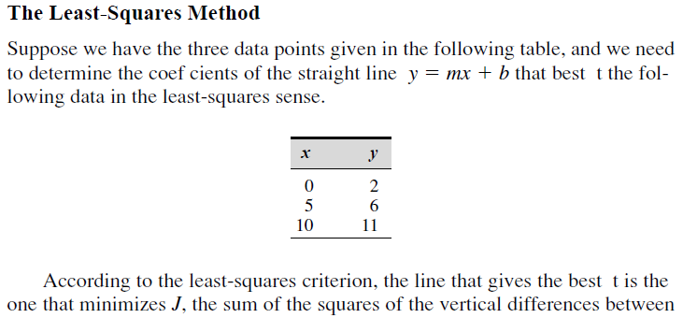
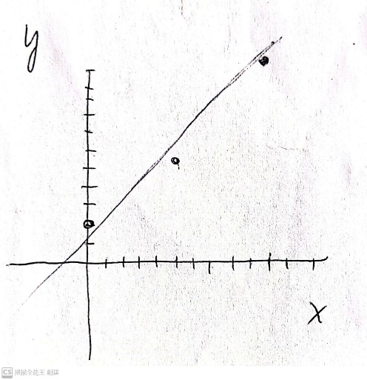
The least square problem
the best fit line is the one that minimizes J,
: sum of the squares of the vertical
differences between the data points and the line.
called residuals.

Slide 3
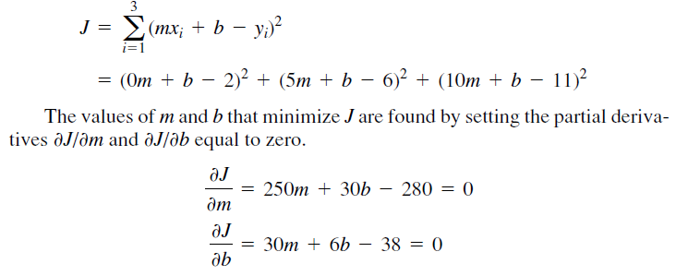
The vertical differences between the line and the data points.
m=0.9, b=11/6

Slide 4
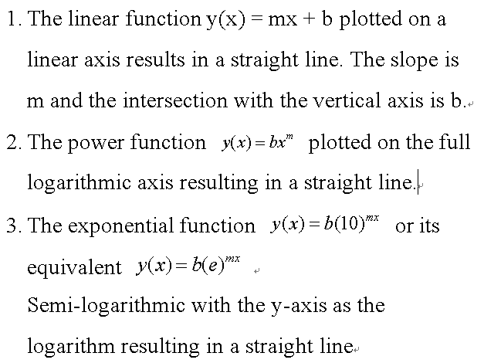
Use linear, power, and exponential functions to describe data
Each function will be a straight line when plotted for the axes
specified in the following columns.

Slide 5
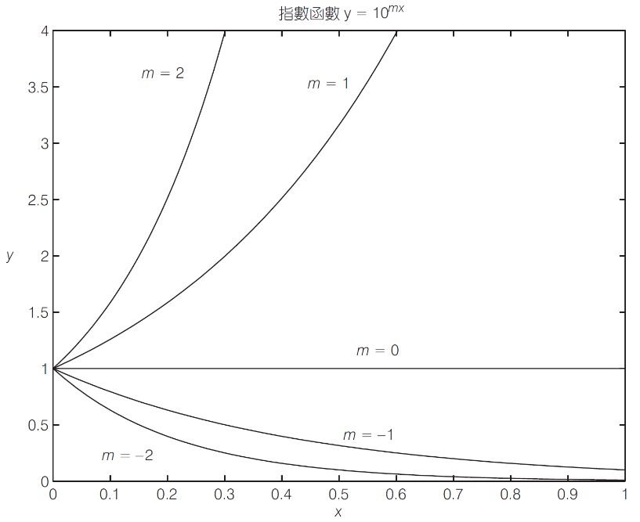
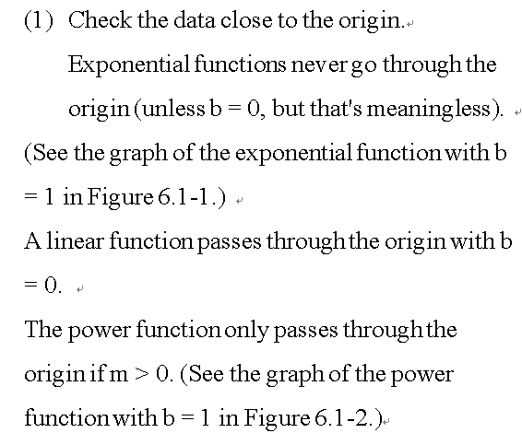
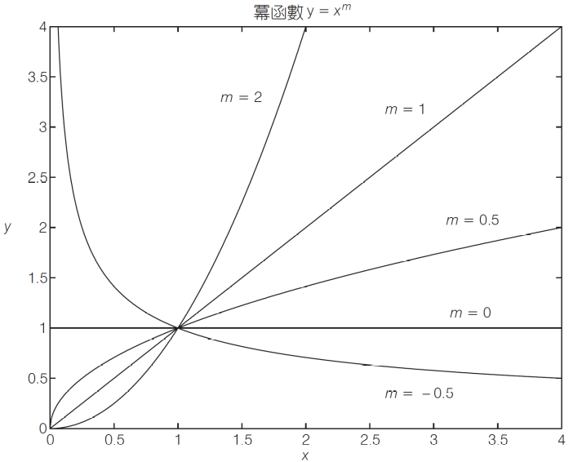
Processing steps to find the fitting function (linear, power, exponential) function.

Slide 6
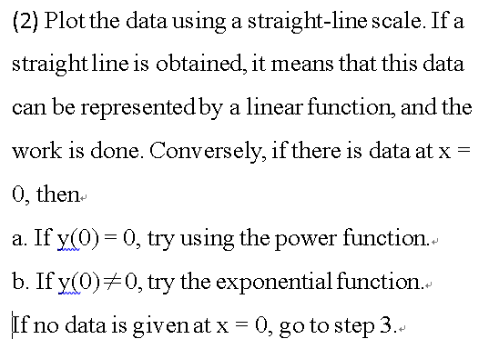

Slide 7
If you suspect a power function, plot the data points on the full-log scale. -- a straight line on a full-logarithmic plot.
exponential function, plot the data on a semi-log scale. -- a straight line on a semi-logarithmic graph.
4. we use full-log or semi-log plots to identify function types, but do not obtain coefficients b and m, one use the polynomial fitting for power & exponential

Slide 8
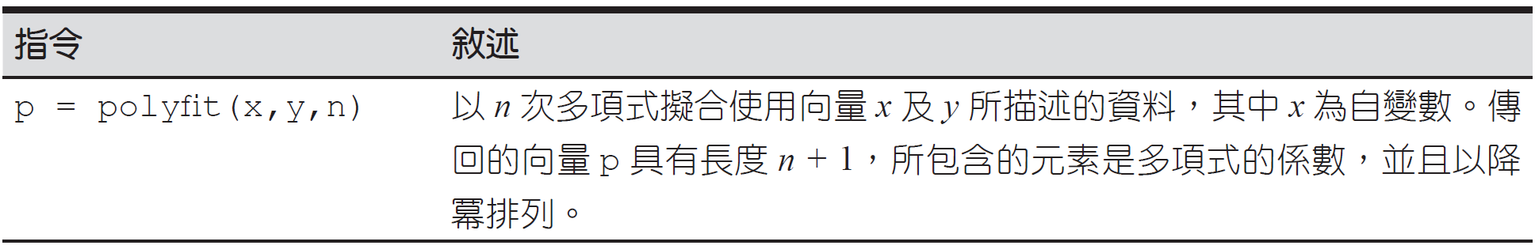
圖 6.1–1 polyfit函數

Slide 9
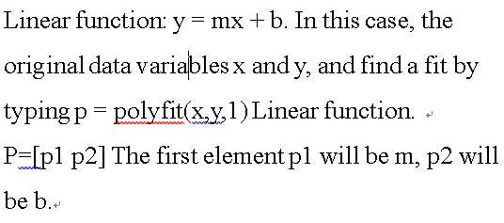
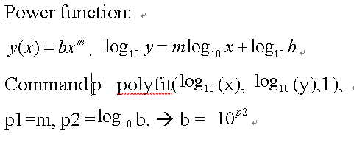
Use polyfit to fitting the data

Slide 10
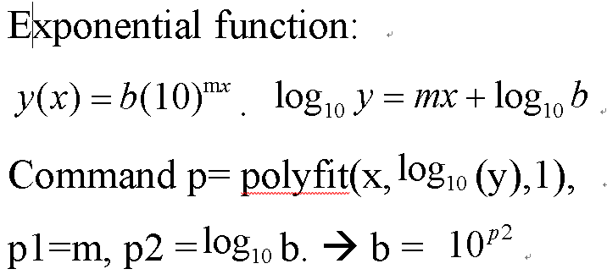
Two examples

Slide 11
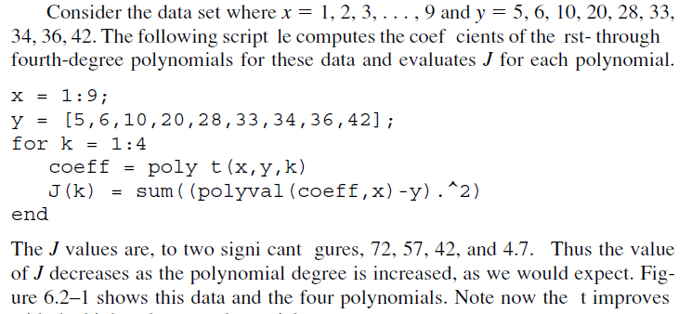
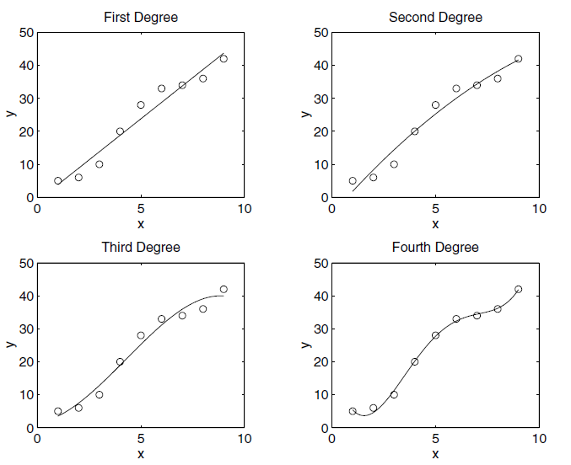
polyfit

Slide 12
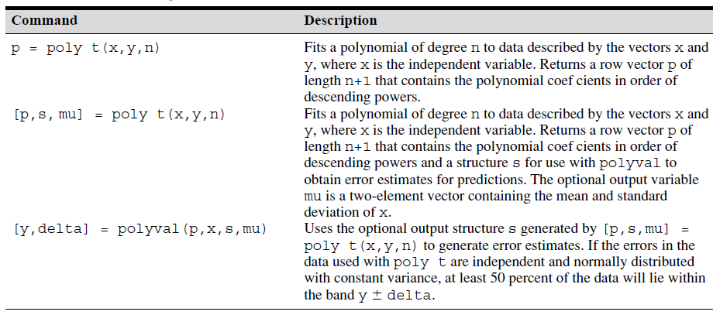
Polynomial regression ｆｕｎｃｔｉｏｎ

Slide 13
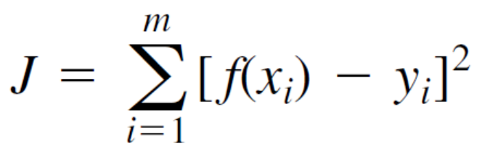
how well the curve fits
We can use the J value to compare how well the curve fits two or more
functions describing the same data.
The function that yields the smallest J value has the best fit to the data..

Slide 14

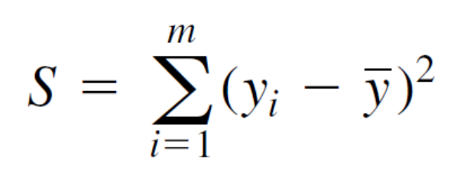
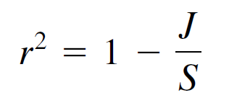
The sum of the squares of the amount
of difference between our label value y and the mean is S,
which we can calculate by the following formula
For a perfect fit, J = 0 and r ２ = 1.
Therefore, the closer r 2 is to 1,
the better the fit; r 2 is at most 1.
J may be greater than S, so r 2 may be negative. If this happens, it means that this is a very bad model.
As a rule of thumb, a good fit should account for at least 99% of the variance in the data. This value corresponds to r 2 ＞＝0.99.

Slide 15
Three examples of the data fitting
Goodness by using r square
Use centering and scaling to improve numerical properties
Create Fit option and Fit type before fitting
Interactive curve (data) and surface fitting
Exercise

